Slide 1

DESIGN AND PERFORMANCE EVALUATION OF A CIRCULARLY POLARISED PHASED ARRAY ANTENNA
Under Guidance of: P.Sathish
B.Uma Mahesh Babu
Presented By:
A Sai Vardhan (1602-23-735-174 )
M Srinivas ( 1602-23-735-182 )
V Srivathsa ( 1602-23-735-183 )

Slide 2
Aim & objectives
Aim
To design and implement a compact microstrip antenna (or array) capable of beamforming with high gain, low side-lobe levels, and efficient beam steering for modern wireless communication systems.
Objectives
To study existing microstrip antenna and beamforming techniques.
To design and simulate a microstrip antenna element with good impedance matching.
To develop an antenna array configuration suitable for directional beam control.
To design and integrate an appropriate feeding or phase-shifting network for beam steering.
To analyze antenna performance through EM simulation (gain, bandwidth, SLL).
To fabricate and experimentally validate the proposed antenna/array design.
To compare measured results with simulations and optimize performance.

Slide 3
introduction
Microstrip antennas are widely used in modern wireless systems because they are low-profile, lightweight, easy to fabricate, and IC-compatible.
They are essential in radar, satellite communication, Wi-Fi/5G, and other compact antenna applications.
Beamforming is a technique that controls antenna array radiation by adjusting phase and amplitude of each element.
Combining microstrip arrays with beamforming enables directional control, improved signal focus, and reduced interference.
This project aims to design a microstrip antenna for beamforming with high gain, low side-lobes, and effective beam steering for next-generation wireless and radar systems.

Slide 4
Problem statement
Conventional antennas have fixed radiation patterns and limited gain, making them less effective for directional communication. Beamforming overcomes this by controlling radiation direction to improve signal strength and reduce interference, but designing compact microstrip arrays with efficient beam steering and low side-lobes remains challenging. This project focuses on developing a microstrip antenna optimized for beamforming to achieve high gain and steerable radiation for modern wireless systems.

Slide 5
Motivation
With the rise of 5G, radar, and satellite systems, there is a growing need for compact and efficient antennas that can dynamically control signal direction. Microstrip antennas are ideal for this due to their low cost and easy circuit integration. Designing a beam-steerable microstrip antenna enhances communication reliability, improves signal quality, and supports advanced smart communication systems.

Slide 6
novelty
The proposed design introduces a compact and cost-effective microstrip antenna array capable of electronic beam steering without mechanical movement. Unlike conventional fixed-pattern antennas, this design integrates a phase-controlled feeding network to achieve directional radiation and improved gain. The antenna is optimized for minimal mutual coupling, low side-lobe levels, and enhanced efficiency, making it suitable for next-generation wireless and radar systems.

Slide 7
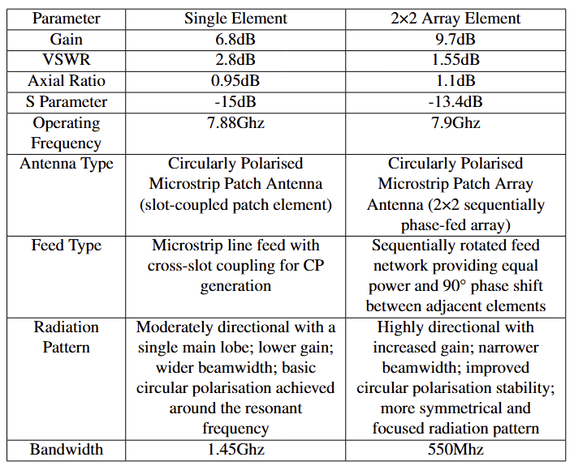
specifications

Slide 8
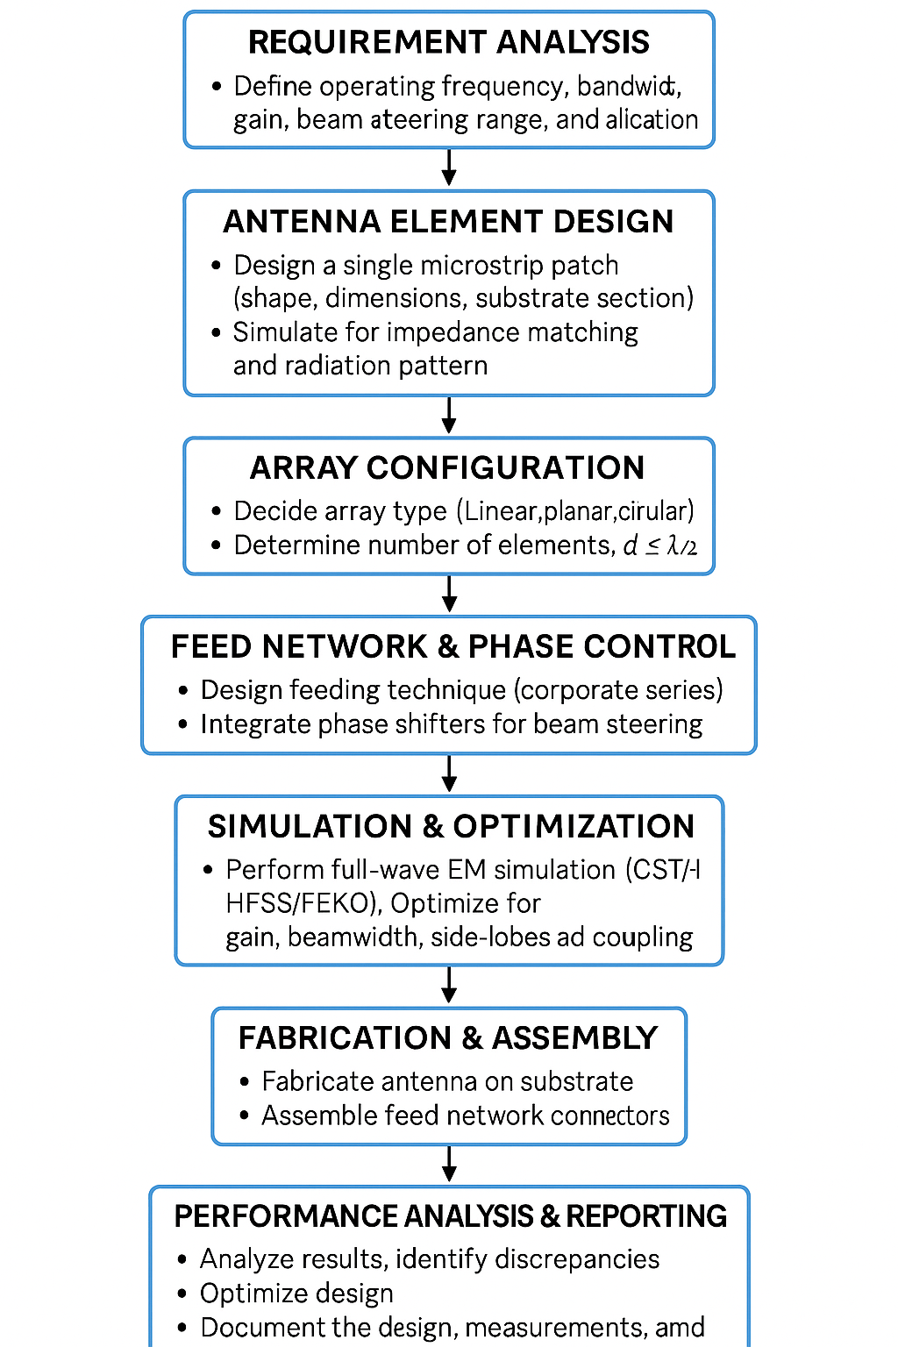
Flowchart

Slide 9
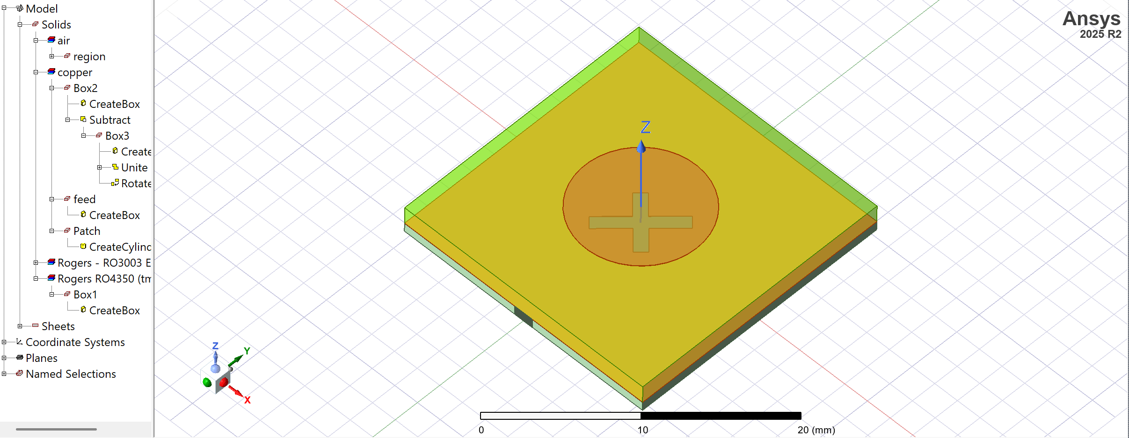
antenna design single element

Slide 10
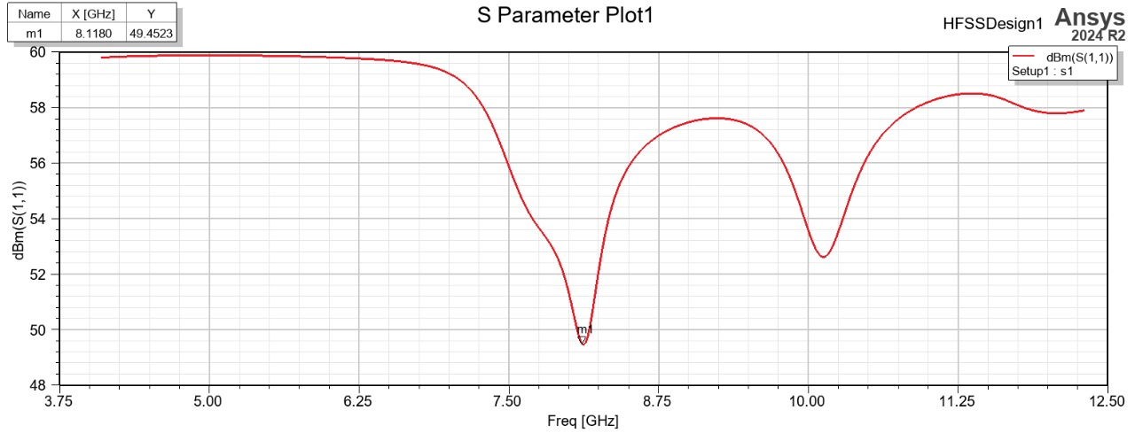
Report of single element

Slide 11
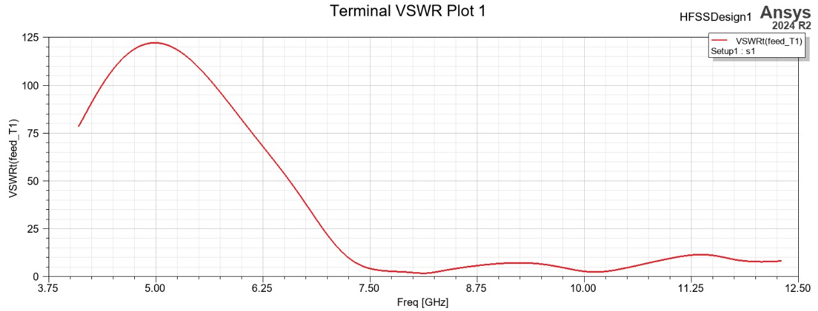
Report of single element

Slide 12
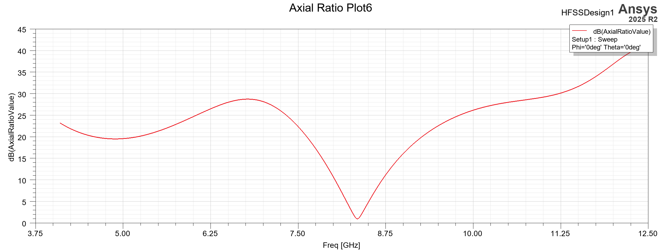
Report of single element

Slide 13
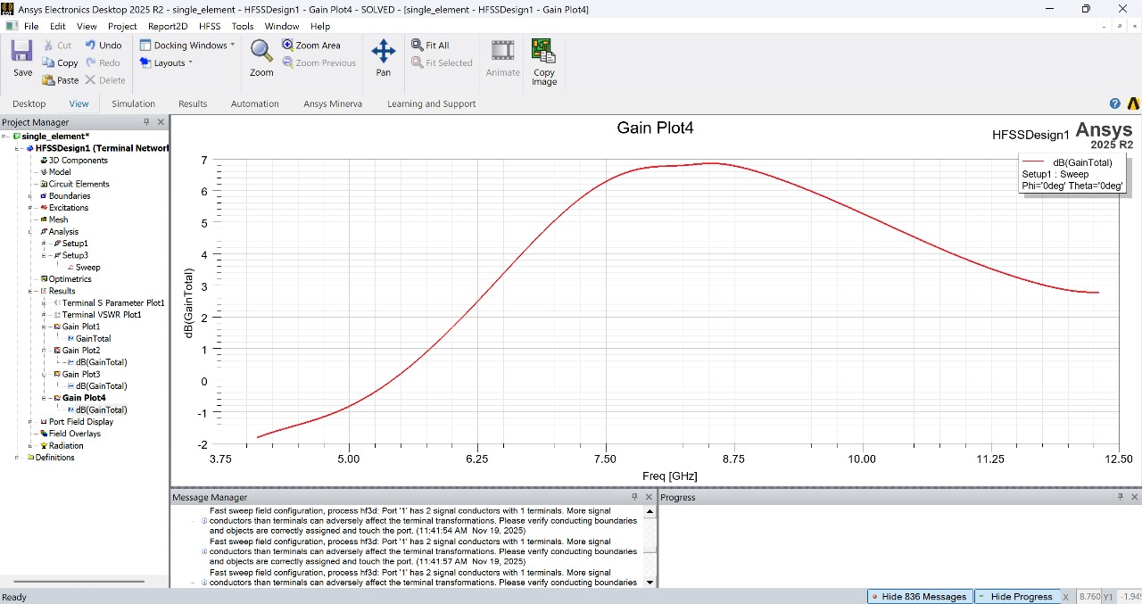
Report of single element

Slide 14
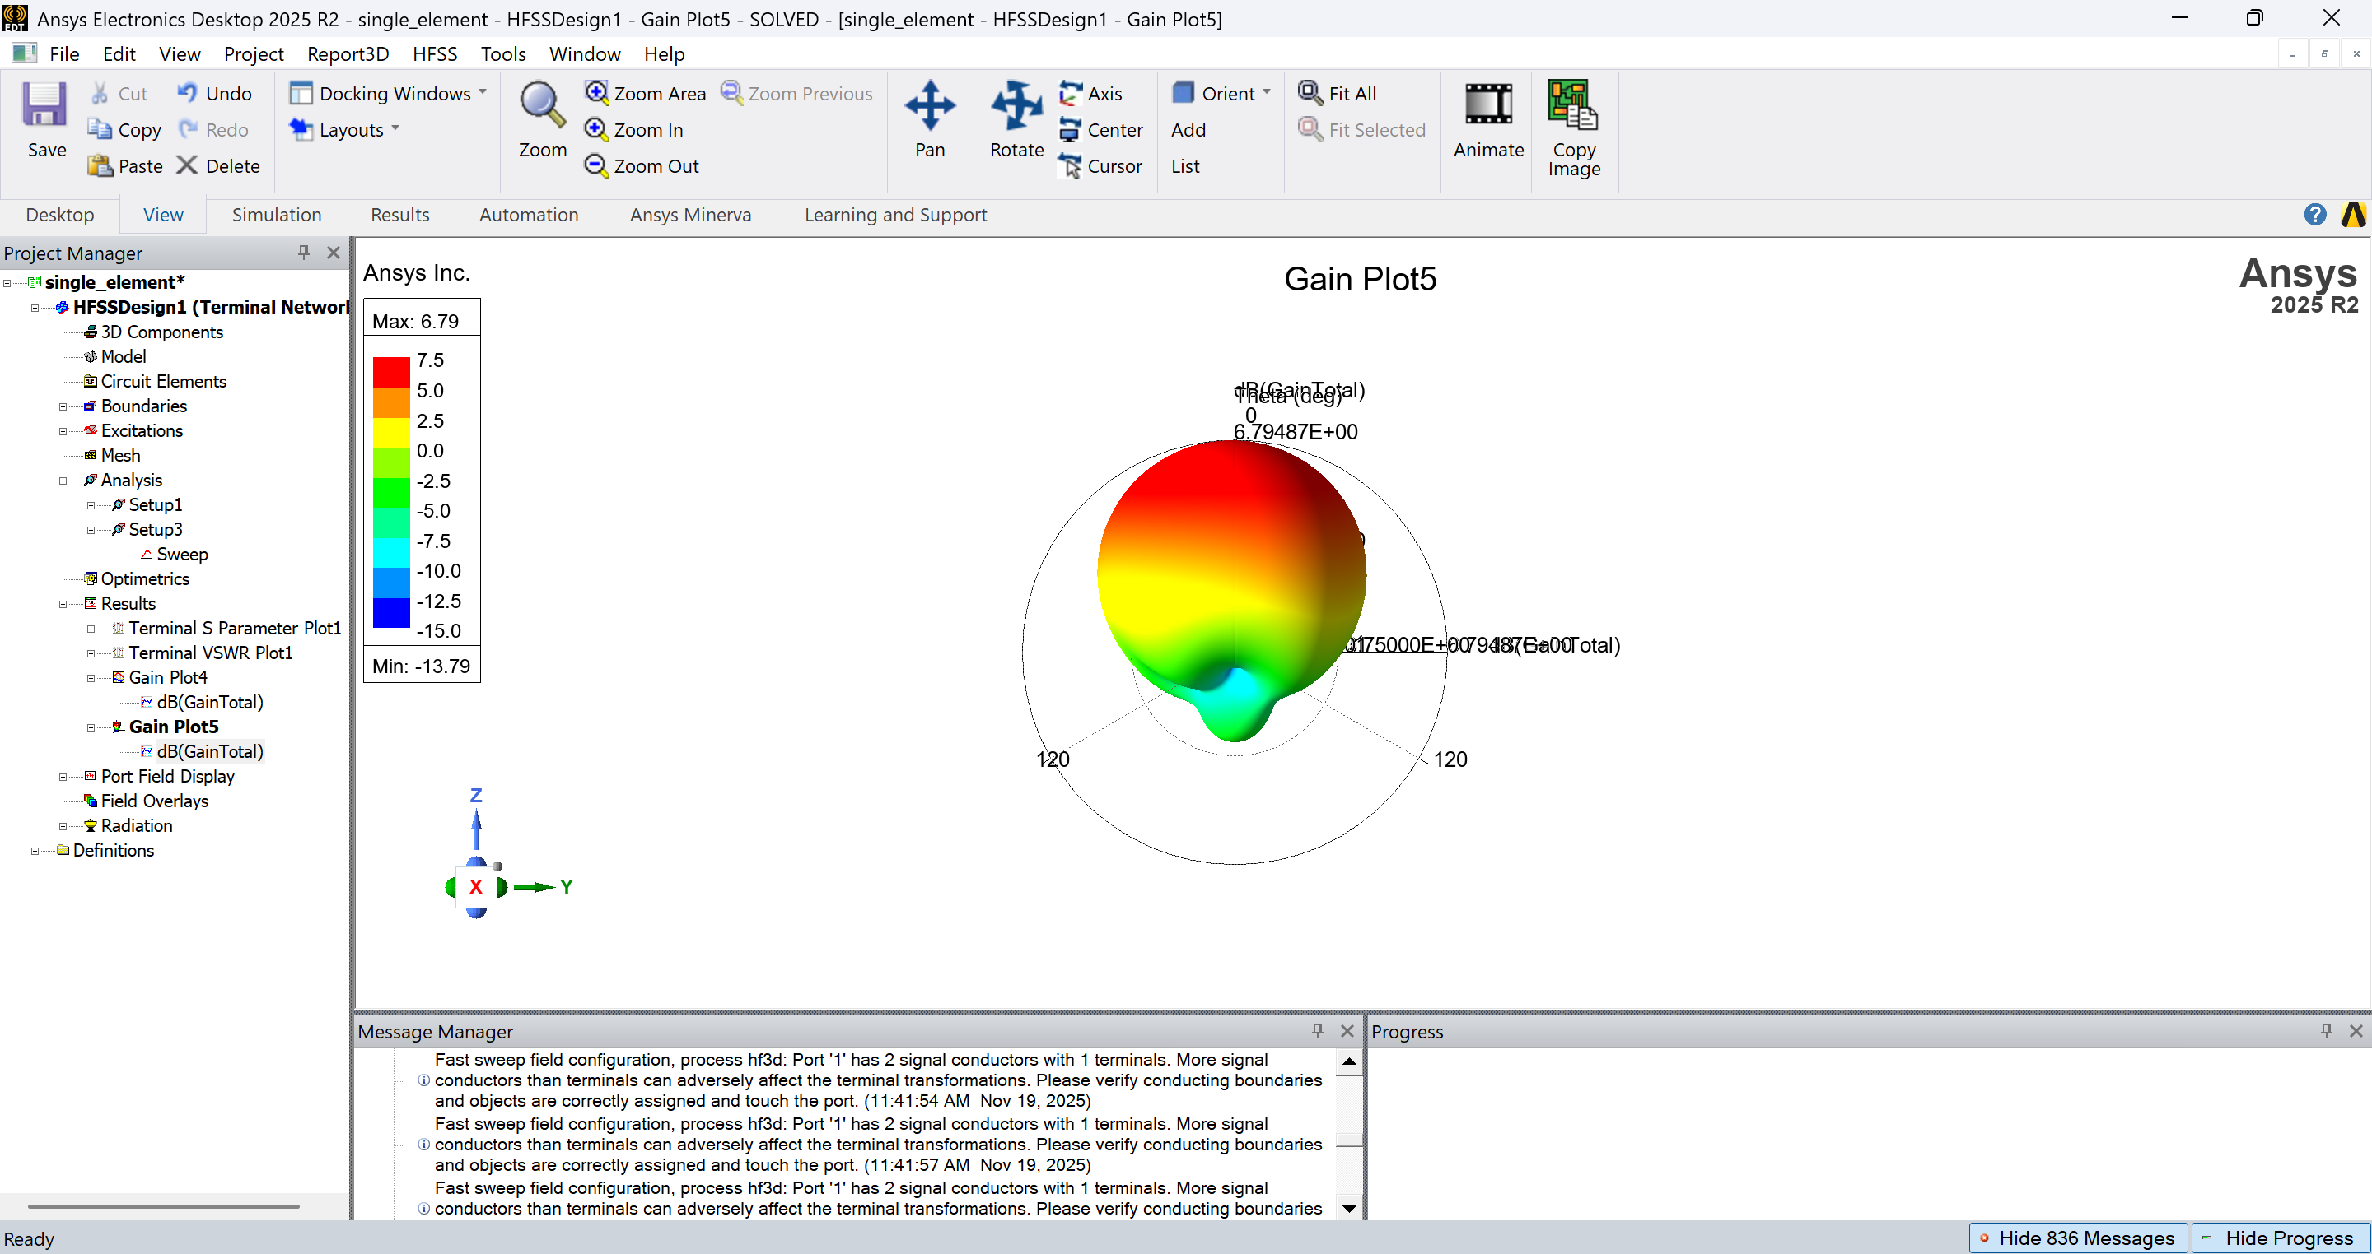
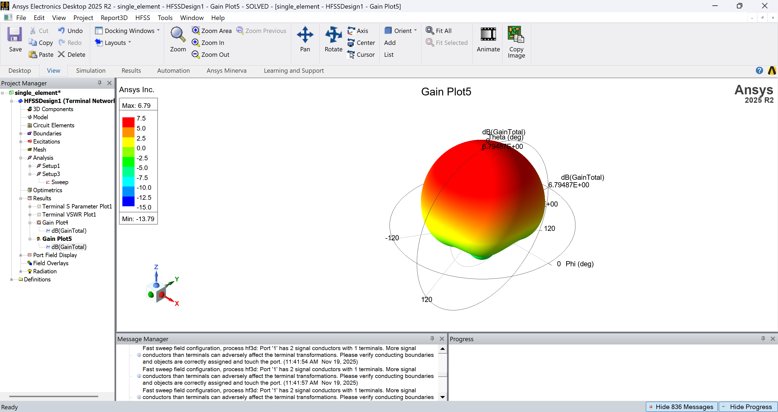
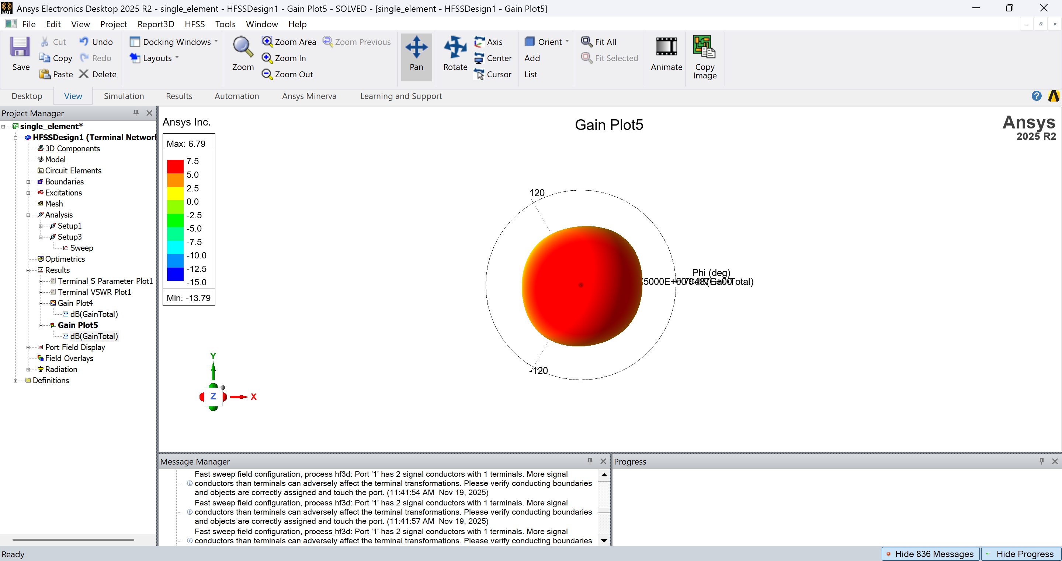
Report of single element

Slide 15
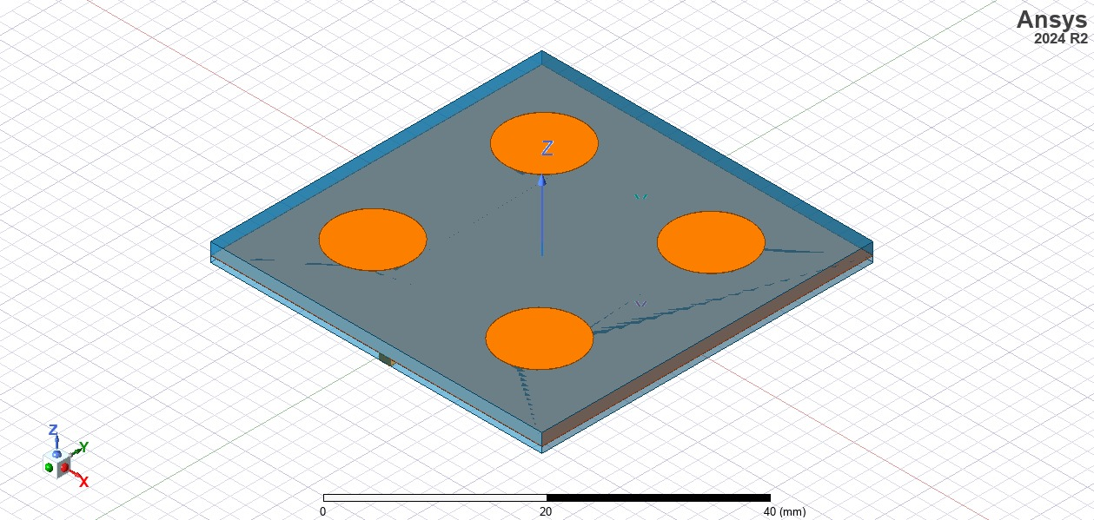
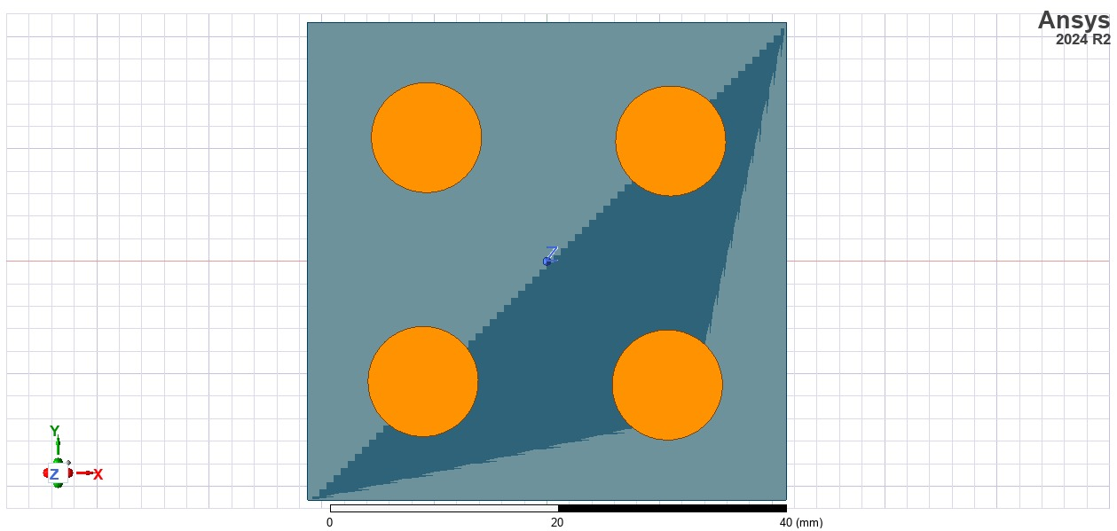
antenna design array antenna

Slide 16
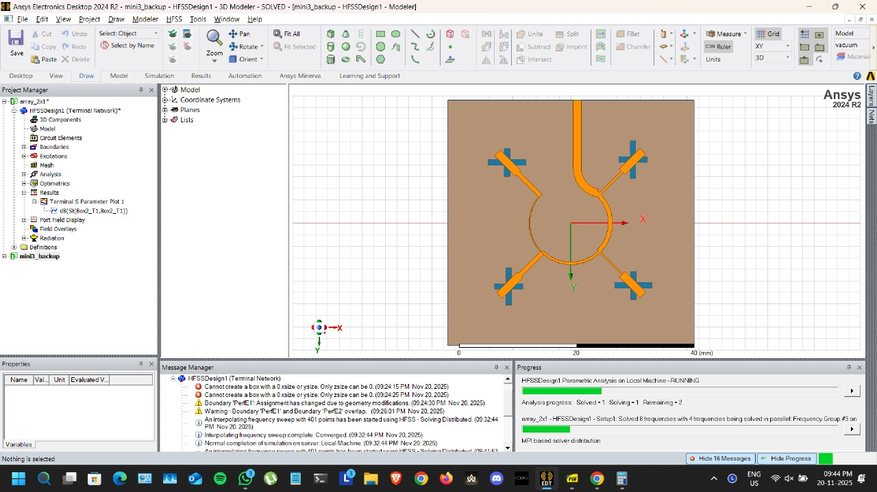
antenna design array antenna

Slide 17
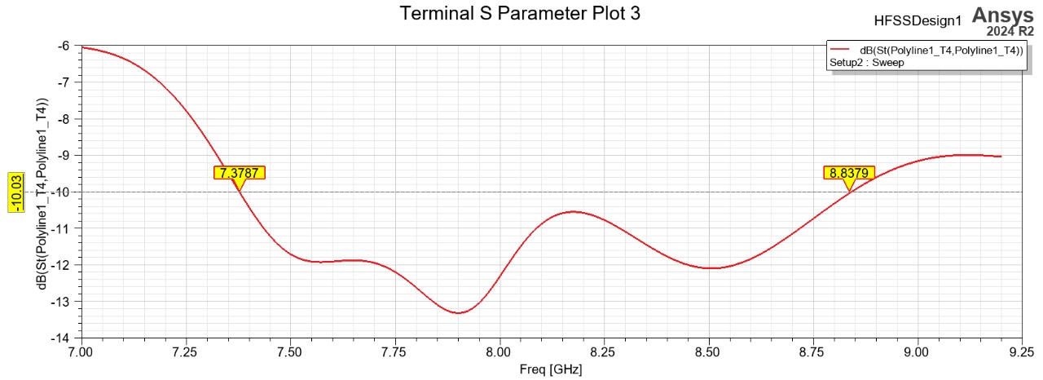
Report of antenna array

Slide 18
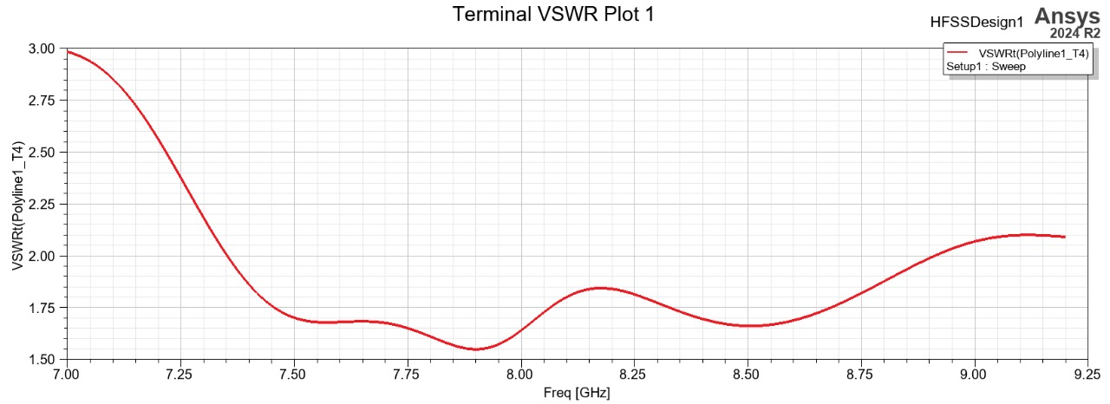
Report of antenna array

Slide 19
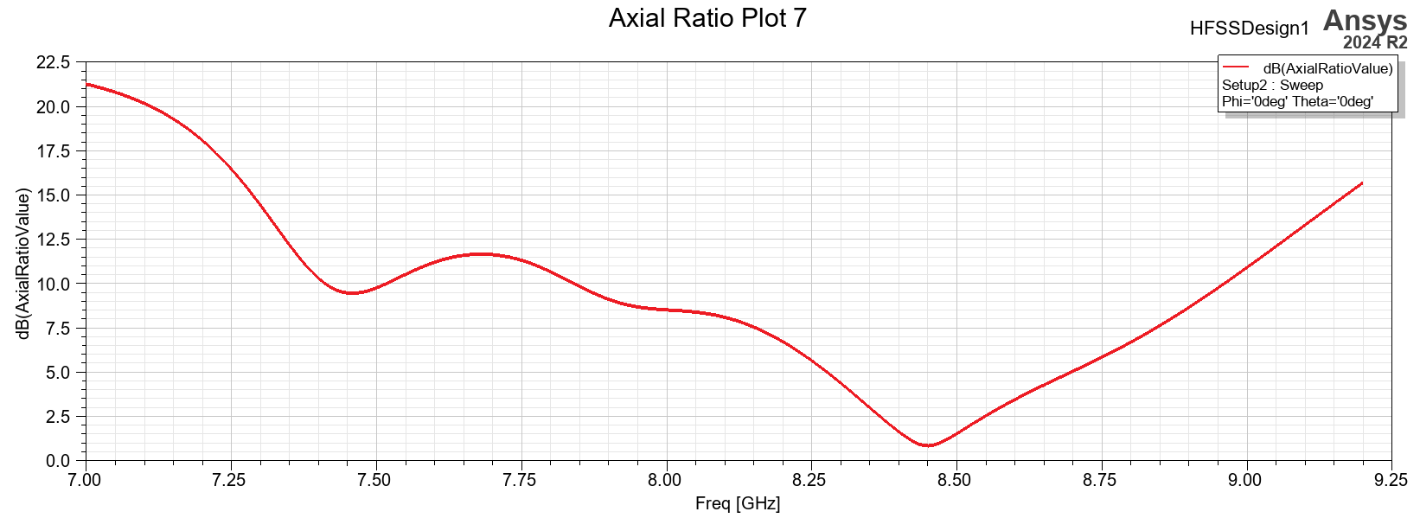
Report of antenna array

Slide 20
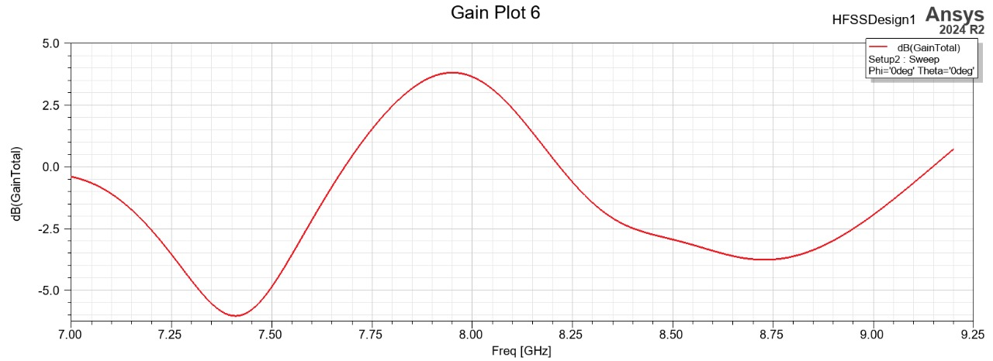
Report of antenna array

Slide 21
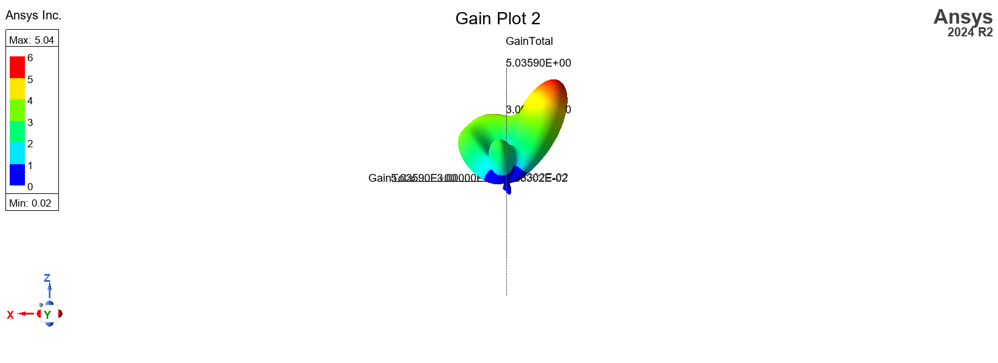
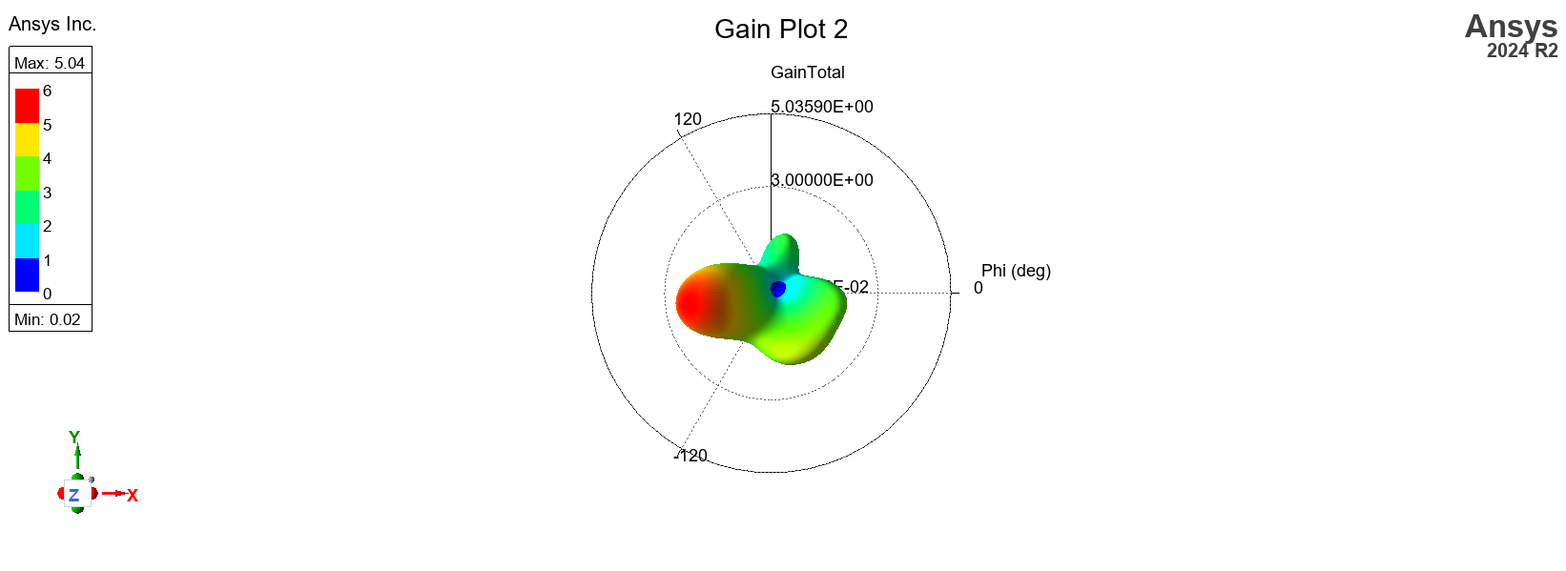
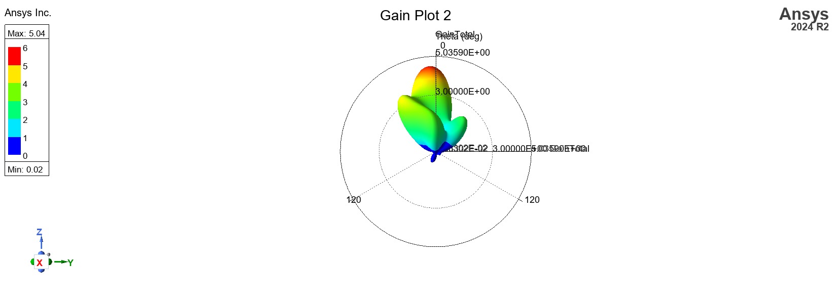
Report of antenna array

Slide 22
References
[1] T.-H. Lee, J. Jung, and S. Pyo, “Circularly Polarized 4×4 Array Antenna with a Wide Axial Ratio Bandwidth,” Electronics, vol. 13, no. 20, p. 2076, 2024.
[2] H. Wang, G. Byun, Y. B. Park, and I. Park, “Circularly Polarized Wideband Unipolar Crossed-Dipole Antenna with Folded Striplines and Rectangular Stubs,” IEEE Access, vol. 11, pp. 63252–63260, 2023.
[3] R. Xu, Z. Shen, and S. S. Gao, “Compact-Size Ultra-Wideband Circularly Polarized Antenna with Stable Gain and Radiation Pattern,” IEEE Transactions on Antennas and Propagation, vol. 70, no. 2, pp. 943–952, 2022.
[4] J.-W. Baik, K.-J. Lee, W.-S. Yoon, T.-H. Lee, and Y.-S. Kim, “Circularly Polarised Printed Crossed Dipole Antennas with Broadband Axial Ratio,” Electronics Letters, vol. 44, no. 14, pp. 785–786, 2008.
[5] H. Baghdadi, G. Royo, I. Bel, F. J. Cortes, and S. Celma, “Compact 2×2 Circularly Polarized Aperture-Coupled Antenna Array for Ka-Band Satcom On-the-Move Applications,” Electronics, vol. 10, no. 14, art. 1621, 2021.
[6] R. L. Farias, C. Peixeiro, and M. V. T. Heckler, “Circularly Polarized 2×2 Microstrip Antenna Array for Application as a Reflectarray Feed,” Microwave and Optical Technology Letters, vol. 61, no. 2, pp. 330–336, 2019.

Slide 23
Thank you

